Slide 1
Heart Disease Prediction using Machine Learning

Slide 2
Introduction
Cardiovascular disease (CVD) is increasing daily in this modern world. According to the World Health Organization (WHO), an estimated 17 million people die each year from cardiovascular disease, particularly heart attacks and strokes . It is, therefore, necessary to record the most important symptoms and health habits that contribute to CVD. Various tests are performed prior to diagnosis of CVD, including auscultation, ECG, blood pressure, cholesterol and blood sugar.

Slide 3
Introduction
These tests are often long and when a patient's condition may be critical and he or she must start taking medication immediately, so it becomes important to prioritize the tests [2]. Several health habits contribute to CVD. Therefore, it is also necessary to know which health habits contribute to CVD. Machine learning is now an emerging field due to the increasing amount of data. Machine learning makes it possible to acquire knowledge from a massive amount of data, which is very heavy for a human and sometimes impossible . The objective of this paper is to prioritize the diagnostic test and to see some of the health habits that contribute to CVD.

Slide 4
Proposed System
We create a gui web framework for representing the output of the heart disease prediction using machine learning algorithm. We take input as collection of heart disease dataset from kaggle website and then train and test using random forest algorithm and then predict based on user input of respective patient.

Slide 5
Dataset
The LIBSVM and the WEKA data mining tool are used to analyze the results of this method. Five data sets (Iris, diabetes disease, breast cancer disease, heart disease and hepatitis) are collected from the Irvine UC machine learning repository for this experiment.
Coronary artery disease is detected and monitored by the proposed system. Cleveland Heart disease dataset is taken from the UCI(Machine learning repository).This dataset consists of 303 cases and 76 attributes/features. 13 features are used out of 76 features.

Slide 6
Software Requirements
Operating system : Windows XP/7/10
Coding Language. : Html, JavaScript,
Development Kit : Flask Framework
IDE : Anaconda prompt

Slide 7
PROCEDURE
Step1: load dataset
Setp2: preprocessing data
Step3: load combined dataset
Step 4:split test and train set from dataset
Step 5: divide features and labels
Step 6: fit train and test set
Step 7: collect input data and give to predict function to get (0,1,2,3,4) values

Slide 8
Features
Age,
Gender – either male or female,
Blood Pressure in mm Hg,
Serum Cholesterol in mg/dL,
Fasting blood sugar – yes if it is greater than 120 mg/dL, else no,
Rest ECG results - Normal.
- Having ST-T wave abnormality, where the ST-T wave known by the T wave
inversions and/or ST elevation or if depression > 0.05 mV.
- Showing Probable or definite left ventricular hypertrophy by Estes’ criteria.
Maximum heart rate achieved during ECG,

Slide 9
Features
Chest pain during exercise – yes/no,
Chest pain type - No chest pain
- Typical angina, which is caused due to emotional or physical stress.
- Atypical angina, which is caused due to discomfort in chest(not severe).
- Non-anginal, which is caused near the sternum or due to pressure(not severe).
- Asymptomatic(If the above symptoms are not applicable).
Left ventricular hypertrophy, or LVH, is a term for a heart's left pumping chamber that has
thickened and may not be pumping efficiently. Sometimes problems such as aortic stenosis
or high blood pressure overwork the heart muscle.

Slide 10
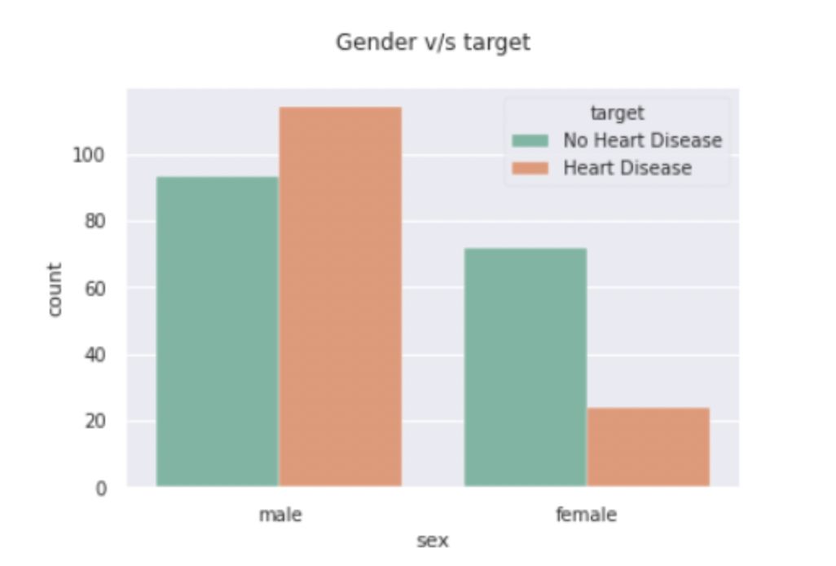
Data Visualization
According to this Cleveland dataset males are more susceptible to get Heart Disease than females. Men experience heart attacks more than women. Sudden Heart Attacks are experienced by men between 70% — 89%. Woman may experience a heart attack with no chest pressure at all, they usually experience nausea or vomiting which are often confused with acid reflux or the flu.

Slide 11
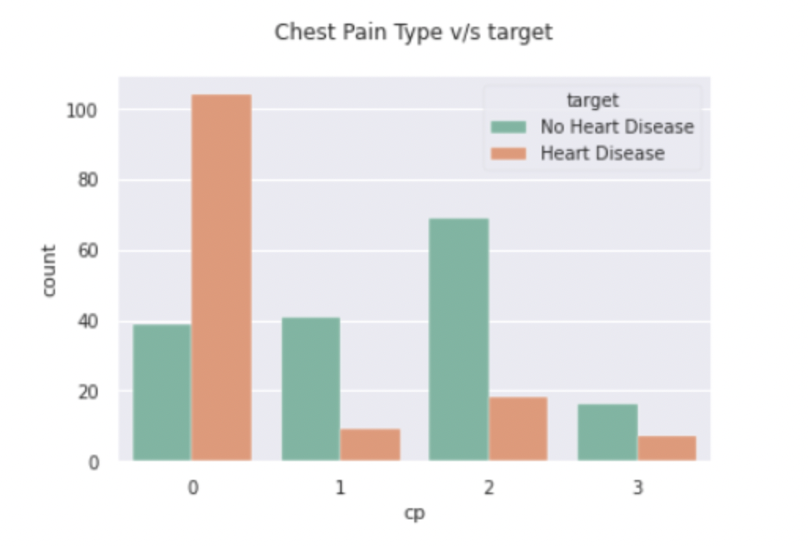
Data Visualization
Most of the Heart Disease patients are found to have asymptomatic chest pain. These group of people might show atypical symptoms like indigestion, flu or a strained chest muscle. A asymptomatic attack, like any heart attack, involves, blockage of blood flow to your heart and possible damage to the heart muscle
The only way to tell If you had asymptomatic attack is by an electrocardiogram or echocardiogram. These tests can reveal changes that signal a heart attack.

Slide 12
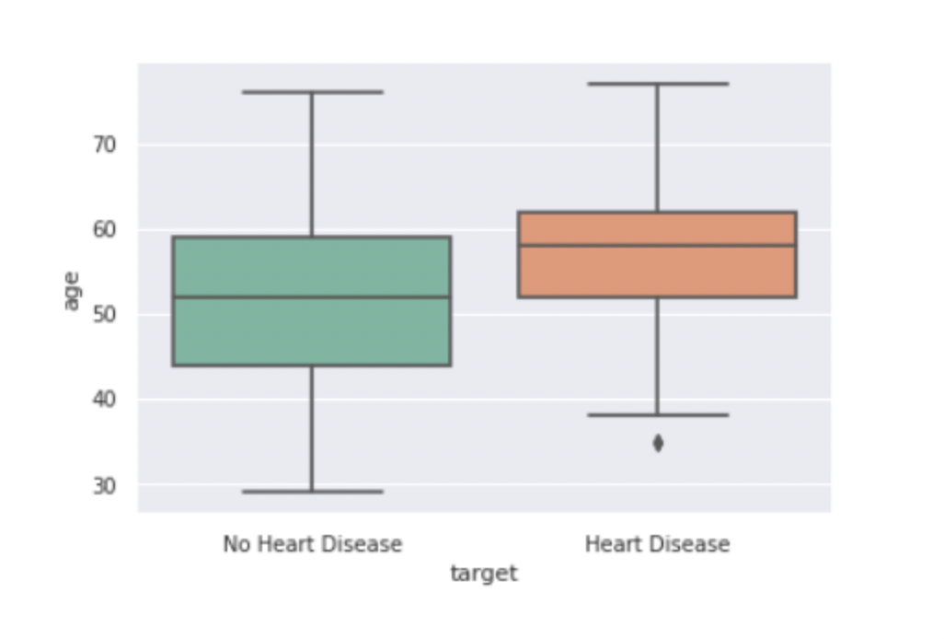
Data Visualization
BOX PLOT
when we create a box plot related to the average of people who have / doesn’t have heart disease we can observe the younger people are less likely to have heart disease.

Slide 13
Modules
Preprocessing Module:
This is preprocessing module where four datasets are converted to supervised learning data and then converted to single combined dataset. This dataset is used as input for application in the next for creating model.
Model training Module:
In this stage combined dataset is taken as in put and model is created using random forest classifier in three steps .
First data is dividing in to testing and training set and features and labels are extracted from these datasets and then data is trained and fitting is done. Then a pkl file is created which is model for this application.
This pkl file is used as model for predicting final results.

Slide 14
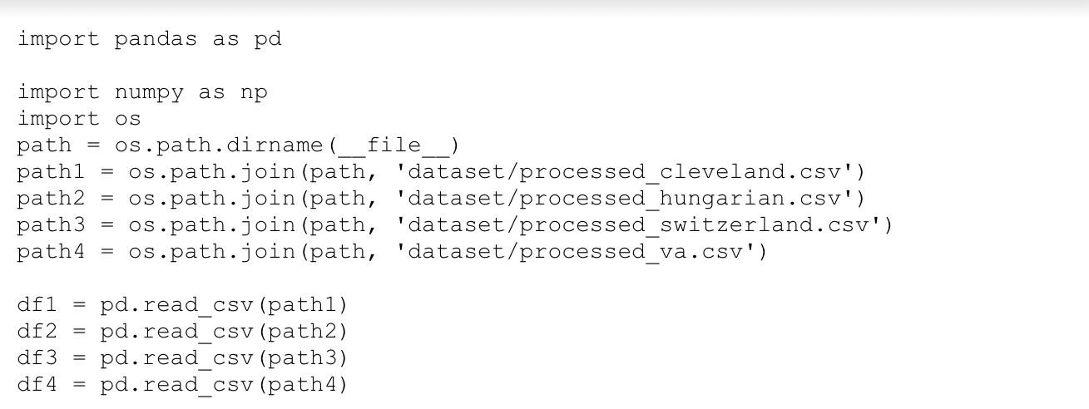
Pre- processing module
We import pandas for data analysis that is for data preprocessing .we use this package to apply operations on datasets for improving the analysis for prediction. Os package for defining the path of datasets located in the directory. Pandas is an open source Python package that is most widely used for data science/data analysis and machine learning tasks. It is built on top of another package named Numpy , which provides support for multi-dimensional arrays. Dataset is in csv format, pd is used to read the dataset and store it in the variables.

Slide 15
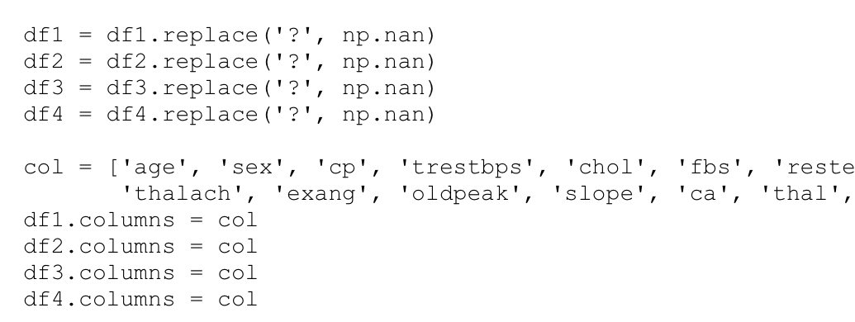
Pre- processing module
As we have gathered all the data and created and stored in the Dataframe, we replace values all inconsistent values with nan. Nan is a numeric data type used to represent any value that is undefined or unpresentable. In the Dataset there are many features,but we select few features that are relevant for our working model.

Slide 16
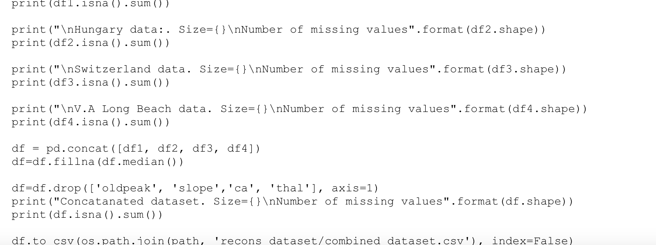
Pre- processing module
We at last concat all 4 datasets and combine them into one dataset. In this resultant dataset .As we have changed all the missing values with nan, We change these nan values with the median values of respective columns. We drop the columns which are not necessary for the application.At the end we save the combined dataset in csv format in specified location.

Slide 17
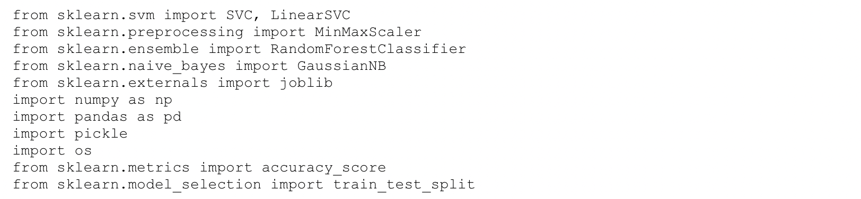
Model Training module
For each value in a feature, MinMaxScaler subtracts the minimum value in the feature and then divides by the range. The range is the difference between the original maximum and original minimum. Pickle is used for serializing and de-serializing Python object structures, also called marshalling or flattening. Serialization refers to the process of converting an object in memory to a byte stream that can be stored on disk or sent over a network.
Joblib provides utilities for loading and saving python objects.

Slide 18
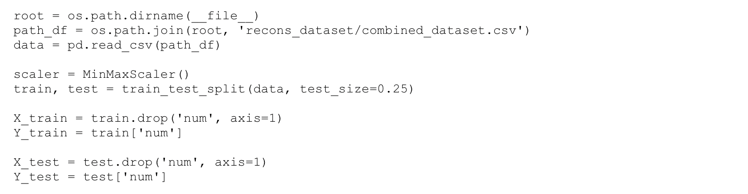
Model Training module
In the preprocessing module we have combined the dataset. This dataset contains features and labels. In Machine Learning feature means property of your training data. Then here Height , Sex and Age are the features. The output you get from your model after training it is called a label. The train-test split procedure is used to estimate the performance of machine learning algorithms when they are used to make predictions on data not used to train the model. The train-test split procedure is used to estimate the performance of machine learning algorithms when they are used to make predictions on data not used to train the model. We use 25% of the records in the combined dataset as the test size. We drop the output column from train data and assign it to y_train data variable.

Slide 19
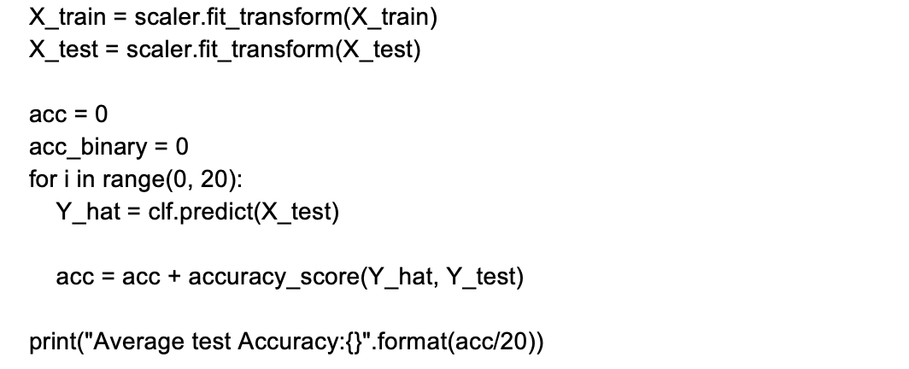
Model Training module
Fit transform is used on the training data so that we can scale the training data and also learn the scaling parameters of that data. These learned parameters are then used to scale our test data. A classifier named clf is defined as an object for our model . The fit method fits the training dataset as features (data) and labels (target) into the Classifier.

Slide 20
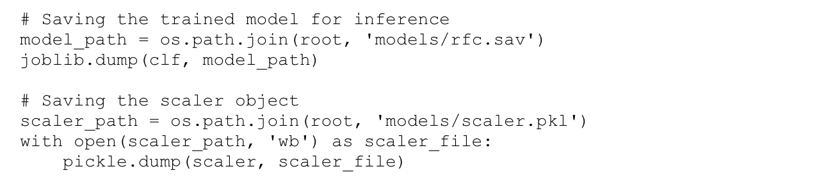
Model Training module
At the end we save the model and scaler file for normalizing the given input corresponding to the normalized data in the dataset.

Slide 21
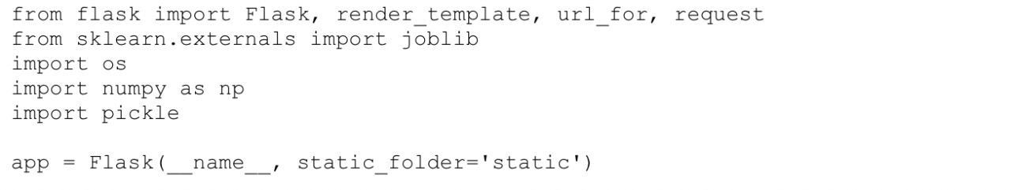
WEB APPLICATION IMPLEMENTATION
Joblib is a set of tools to provide lightweight pipelining in Python.
dirname() method in Python is used to get the directory name from the specified path.
Flask is a web framework. It provides tools, libraries and technologies that allow you to build a web application. From the flask, render_template is imported to generate output from a template file.

Slide 22
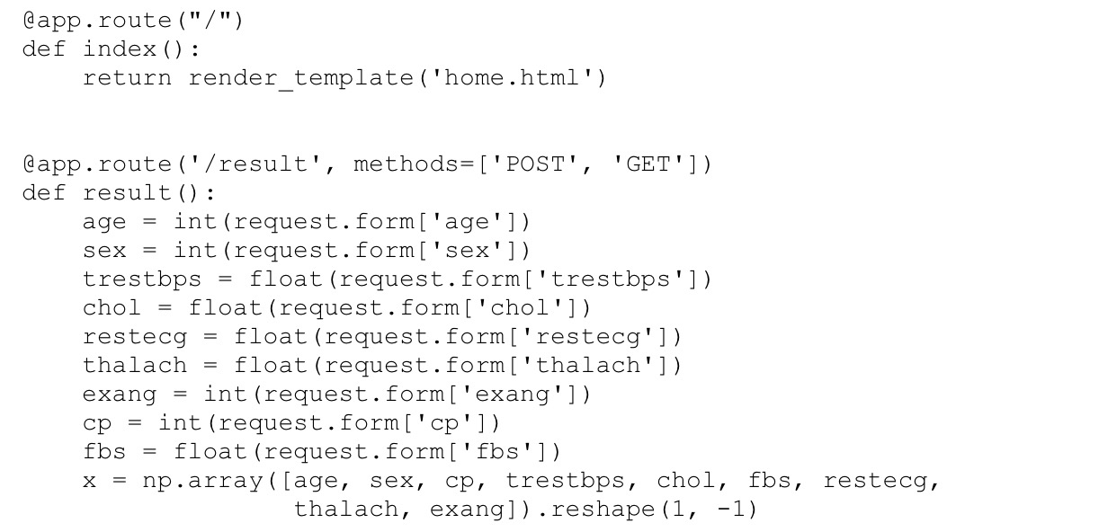
WEB APPLICATION IMPLEMENTATION
App routing is used to map the specific URL with the associated function that is intended to perform some task. It is used to access some particular page in the web application.
Here we are storing the input from the form in variables
And storing them in an array.

Slide 23
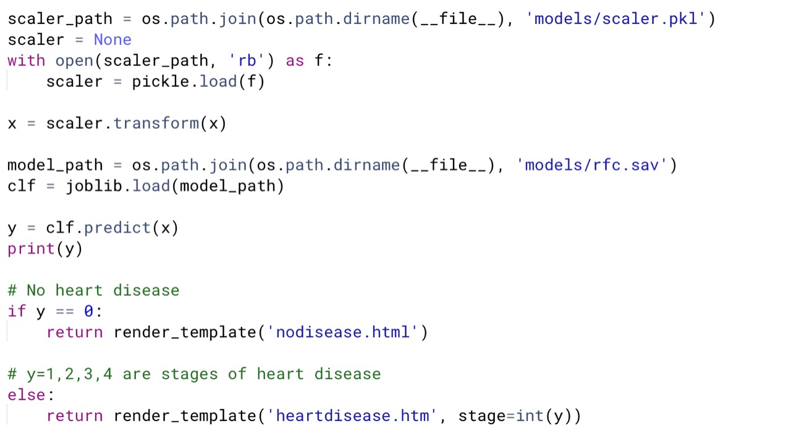
WEB APPLICATION IMPLEMENTATION
Joblib is a set of tools to provide lightweight pipelining in Python. dirname() method in Python is used to get the directory name from the specified path. Using dirname() scaler_path and model_path are retrieved with the respective paths. The output of the data that is no heart disease or stages of it are displayed by returning the render_template.

Slide 24
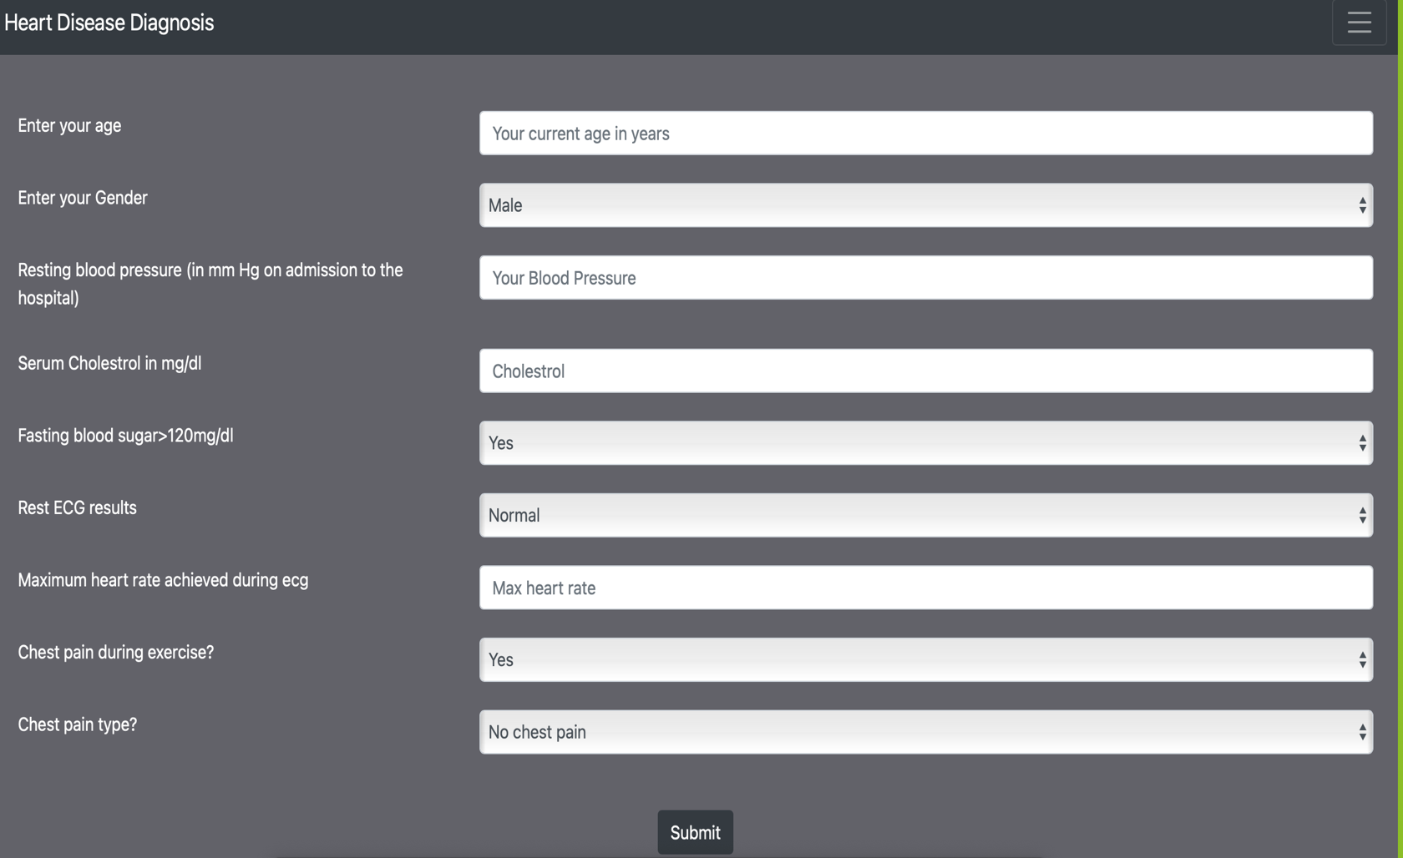
WEB PAGE

Slide 25
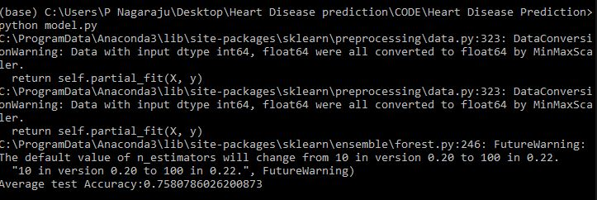
Results
Model Accuracy:
Model accuracy is defined as the number of classifications a model correctly predicts divided by the total number of predictions made. It's a way of assessing the performance of a model.We have used RandomForestClassifier for the model, we have achieved 75% average test accuracy.

Slide 26
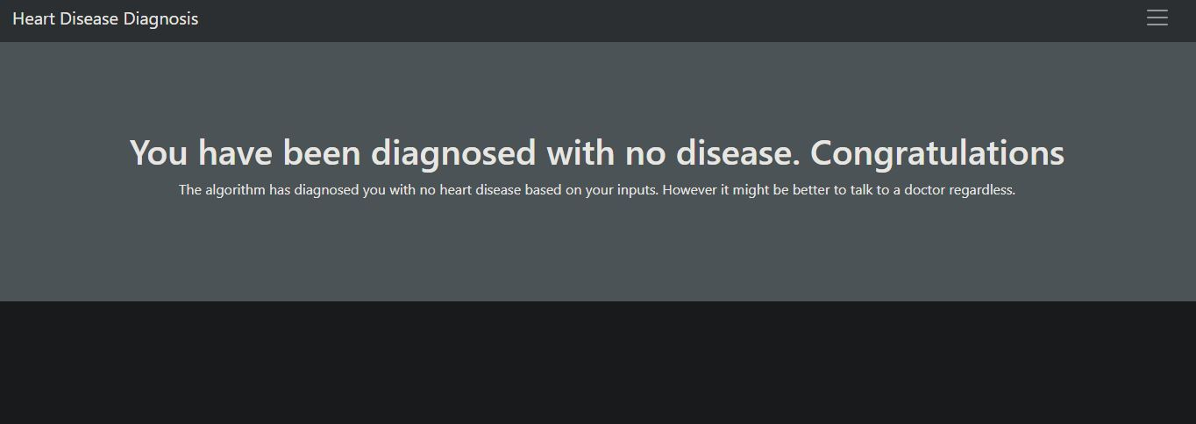
Results
Results in Web page:
From the web page the user gives input for the diagnosis of heart disease. We randomly select the data input or we test through the input given from the dataset .Here for a given set of data input the resultant diagnosis predicts no disease.

Slide 27
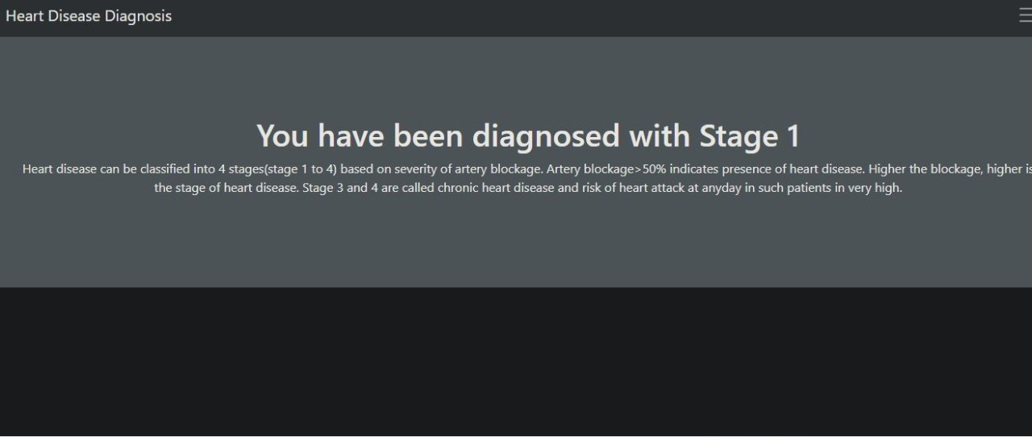
Results
Results in Web page:
User diagnosed with stage 1 of heart disease which in this case is risk of heart attack is very low. i.e the specified artery blockage is less than 50%.

Slide 28
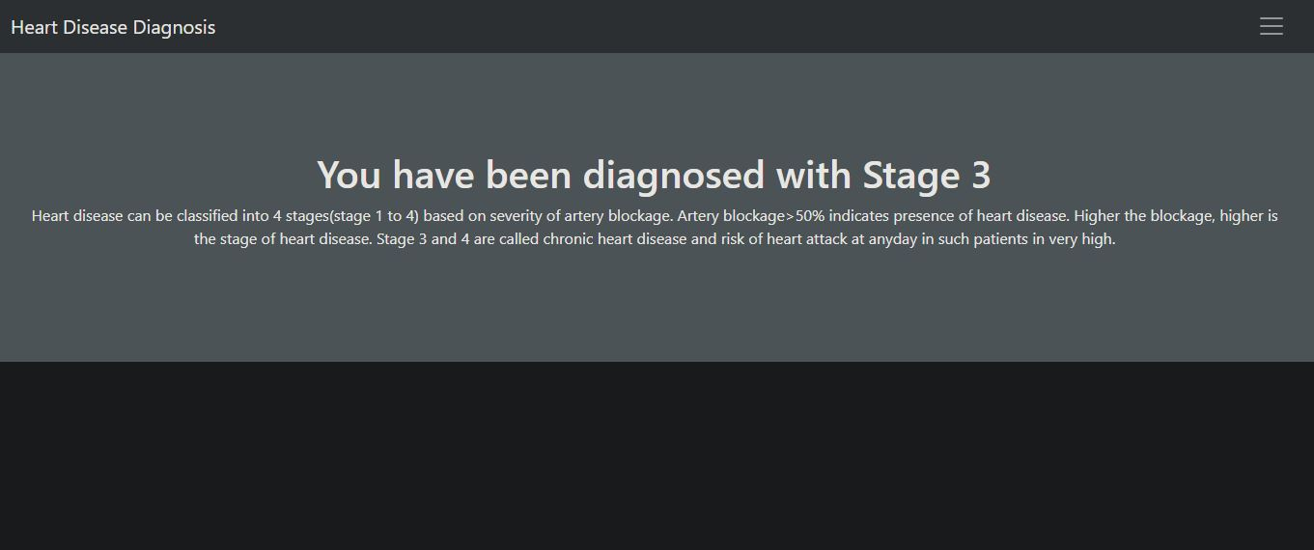
Results
Results in Web page:
User diagnosed with stage 3 or 4 of heart disease which in this case is risk of heart attack is very high. i.e the specified artery blockage is more than 50%.

Slide 29
References
K. Gai, M. Qiu, Z. Xiong, and M. Liu, “Privacy-preserving multi-channel communication in Edge-of-Things,” Future Generation Computer Systems, 85, 2018, pp. 190-200.
K. Gai, M. Qiu, and X. Sun, “A survey on FinTech,” Journal of Network and Computer Applications, 2017, pp. 1-12.
Abbas, K. Bilal, L. Zhang, and S. U. Khan, “A cloud based health insurance plan recommendation system: A user cen-tered approach, “Future Generation Computer Systems, vols. 43-44, pp. 99-109, 2015.
N. Khan, ML M. Kiah, S. A. Madani, M. Ali, and S. Sham-shirband, “Incremental proxy re-encryption scheme for mo-bile cloud computing environment,”The Journal of Supercom-puting,Vol. 68, No. 2, 2014, pp. 624-651.

Slide 30
END
Thank You

